Slide 1
Displacement and Velocity

Slide 2
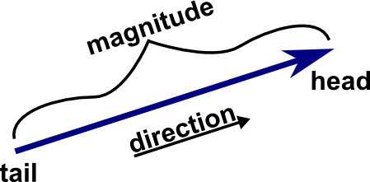
Scalars and Vectors
Quantities that need magnitude and units are called scalar quantities. They do not need direction.
A Vector is a geometric object that has magnitude (or length) and direction.

Slide 3
Scalars
Time
Distance
Volume
Speed
temperature
Vectors
-position
-displacement
-velocity
-acceleration
-force
-momentum
-current

Slide 4
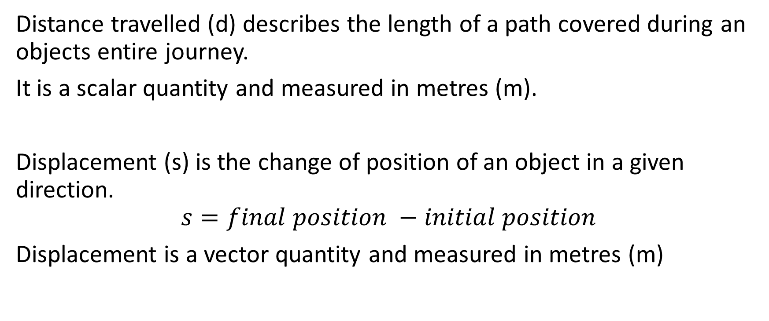
Distance travelled vs displacement
Distance travelled (d) describes the length of a path covered during an objects entire journey.
It is a scalar quantity and measured in metres (m).
Displacement (s) is the change of position of an object in a given direction.
$$s=final position −initial position$$
Displacement is a vector quantity and measured in metres (m)

Slide 5
Check
Phillip swims two laps of a 50m pool, up and back.
What is the distance he swam?
What is his final displacement?

Slide 6
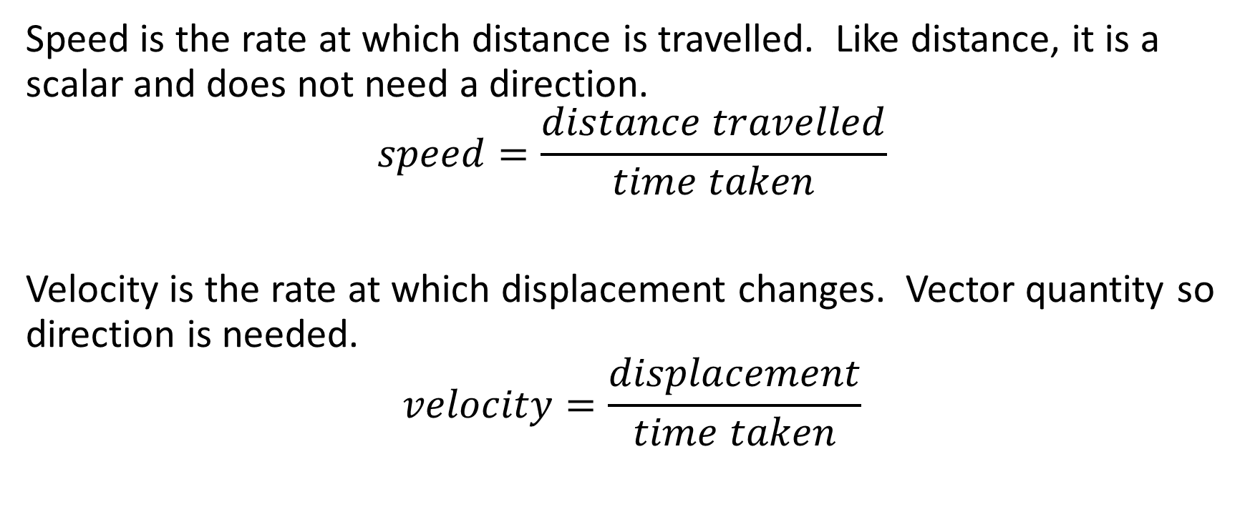
Speed vs velocity
Speed is the rate at which distance is travelled. Like distance, it is a scalar and does not need a direction.
$$speed=\frac{distance travelled}{time taken}$$
Velocity is the rate at which displacement changes. Vector quantity so direction is needed.
$$velocity=\frac{displacement}{time taken}$$

Slide 7
Check
Margaret raced Phil over the first 50m of his swim. It took her 21s to complete the lap. She started at the south end of the pool.
What was her swimming speed?
What was her swimming velocity?

Slide 8
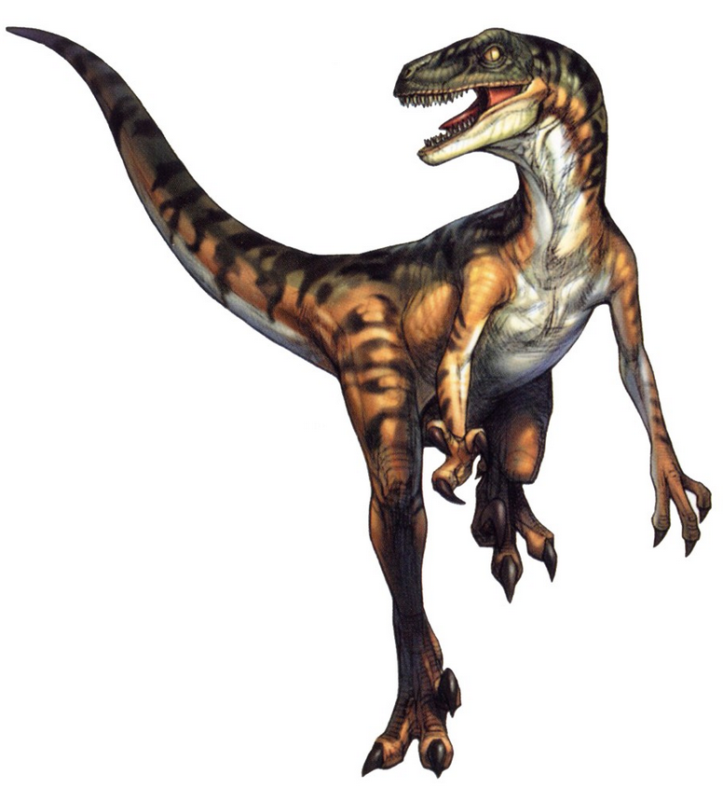

$$Velociraptor=\frac{Displacementraptor}{Timeraptor}$$

